Slide 1
Write a python program that asks a (student) name, surname and grades for SIW, Midterm and Final exams from a user and calculates the average of grades. If the average and final exam grade is higher than 50 or equal to 50 output: “You have passed”, if the average and final exam grade is less than 50 then output “You have failed”.

Slide 2
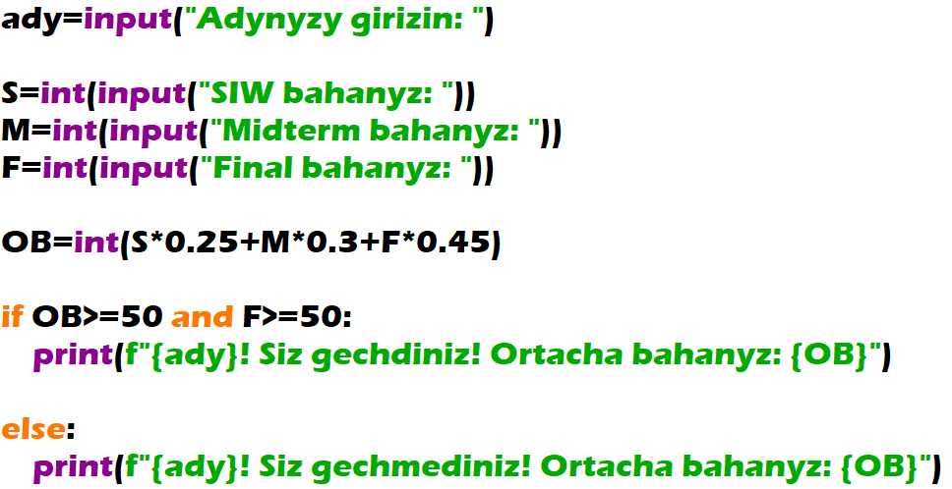
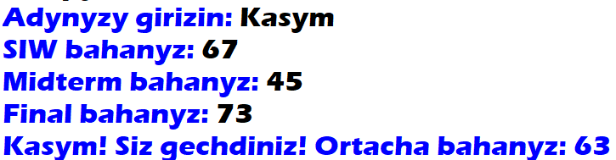

Slide 3
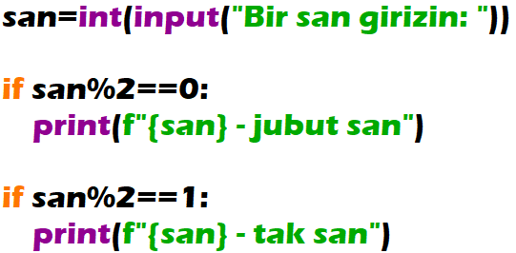

By user given a number. If the number is even then the program outputs: “The number is even”. But if the number is odd then the program outputs: “The number is odd”.

Slide 4
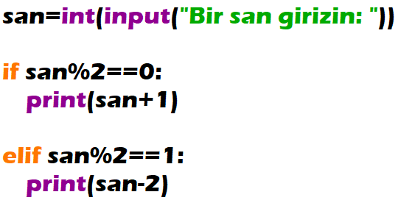

Get from user a number. If the number is even, then add 1 to that number, else minus 2 from that number. Output the gotten number.

Slide 5
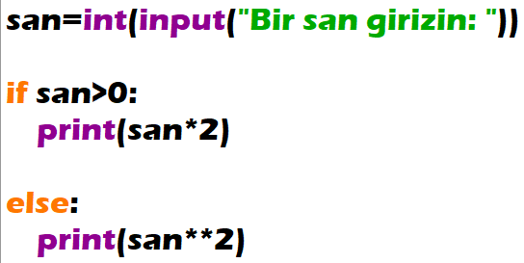

Ulanyjydan bir san almaly. Eger-de alnan san položitel bolsa sany 2 esse artdyrmaly,otrisatel bolsa sany 2-nji derejä götermeli. Netijäni print etmeli.

Slide 6
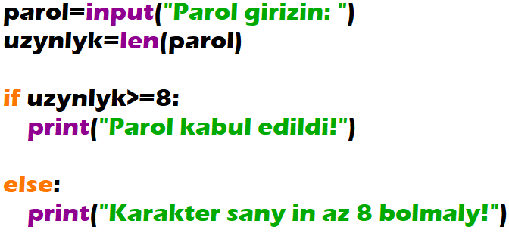

Ulanyjydan parol almaly. Parolyň karakter sany 8-e deň ýa-da uly bolsa paroly kabul etmeli, 8- den az bolsa kabul etmeli däl.

